Slide 1
The Chi-Square Statistic

Slide 2
This chapter introduces two non-parametric hypothesis tests using the chi-square statistic: the chi-square test for goodness of fit and the chi-square test for independence.

Slide 3
The term "non-parametric" refers to the fact that the chi‑square tests do not require assumptions about population parameters nor do they test hypotheses about population parameters.
Previous examples of hypothesis tests, such as the t tests and analysis of variance, are parametric tests and they do include assumptions about parameters and hypotheses about parameters.

Slide 4
The most obvious difference between the chi‑square tests and the other hypothesis tests we have considered (t and ANOVA) is the nature of the data.
For chi‑square, the data are frequencies rather than numerical scores.

Slide 5
The Chi-Square Test for Goodness-of-Fit
The chi-square test for goodness-of-fit uses frequency data from a sample to test hypotheses about the shape or proportions of a population.
Each individual in the sample is classified into one category on the scale of measurement.
The data, called observed frequencies, simply count how many individuals from the sample are in each category.

Slide 6
The Chi-Square Test for Goodness-of-Fit (cont.)
The null hypothesis specifies the proportion of the population that should be in each category.
The proportions from the null hypothesis are used to compute expected frequencies that describe how the sample would appear if it were in perfect agreement with the null hypothesis.

Slide 7
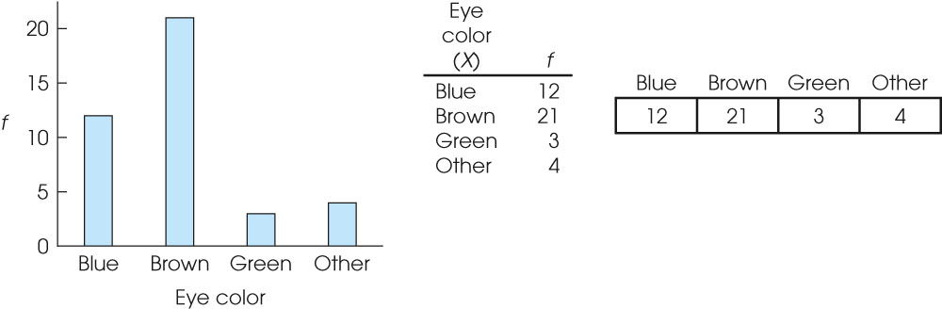
Notes:
Figure 18.1
Distribution of eye colors for a sample of n = 40 individuals. The same frequency distribution is shown as a bar graph, as a table, and with the frequencies written in a series of boxes.

Slide 8
The Chi-Square Test for Independence
The second chi-square test, the chi-square test for independence, can be used and interpreted in two different ways:
1. Testing hypotheses about the relationship between two variables in a population, or
2. Testing hypotheses about differences between proportions for two or more populations.

Slide 9
The Chi-Square Test for Independence (cont.)
Although the two versions of the test for independence appear to be different, they are equivalent and they are interchangeable.
The first version of the test emphasizes the relationship between chi-square and a correlation, because both procedures examine the relationship between two variables.

Slide 10
The Chi-Square Test for Independence (cont.)
The second version of the test emphasizes the relationship between chi-square and an independent-measures t test (or ANOVA) because both tests use data from two (or more) samples to test hypotheses about the difference between two (or more) populations.

Slide 11
The Chi-Square Test for Independence (cont.)
The first version of the chi-square test for independence views the data as one sample in which each individual is classified on two different variables.
The data are usually presented in a matrix with the categories for one variable defining the rows and the categories of the second variable defining the columns.

Slide 12
The Chi-Square Test for Independence (cont.)
The data, called observed frequencies, simply show how many individuals from the sample are in each cell of the matrix.
The null hypothesis for this test states that there is no relationship between the two variables; that is, the two variables are independent.

Slide 13
The Chi-Square Test for Independence (cont.)
The second version of the test for independence views the data as two (or more) separate samples representing the different populations being compared.
The same variable is measured for each sample by classifying individual subjects into categories of the variable.
The data are presented in a matrix with the different samples defining the rows and the categories of the variable defining the columns..

Slide 14
The Chi-Square Test for Independence (cont.)
The data, again called observed frequencies, show how many individuals are in each cell of the matrix.
The null hypothesis for this test states that the proportions (the distribution across categories) are the same for all of the populations

Slide 15
The Chi-Square Test for Independence (cont.)
Both chi-square tests use the same statistic. The calculation of the chi-square statistic requires two steps:
1. The null hypothesis is used to construct an idealized sample distribution of expected frequencies that describes how the sample would look if the data were in perfect agreement with the null hypothesis.

Slide 16
The Chi-Square Test for Independence (cont.)
For the goodness of fit test, the expected frequency for each category is obtained by
expected frequency = f_{e} = pn
(p is the proportion from the null hypothesis and n is the size of the sample)
For the test for independence, the expected frequency for each cell in the matrix is obtained by
(row total)(column total)
expected frequency = f_{e} = ─────────────────
n

Slide 17
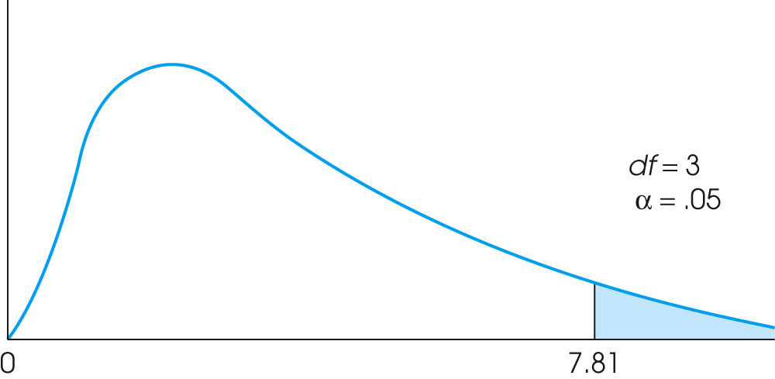
Notes:
Figure 18.4
For Example 18.1, the critical region begins at a chi-square value of 7.81.

Slide 18
The Chi-Square Test for Independence (cont.)
2. A chi-square statistic is computed to measure the amount of discrepancy between the ideal sample (expected frequencies from H₀) and the actual sample data (the observed frequencies = f_{o}).
A large discrepancy results in a large value for chi-square and indicates that the data do not fit the null hypothesis and the hypothesis should be rejected.

Slide 19
The Chi-Square Test for Independence (cont.)
The calculation of chi-square is the same for all chi-square tests:
(f_{o} – f_{e})²
chi-square = χ² = Σ ─────
f_{e}
The fact that chi‑square tests do not require scores from an interval or ratio scale makes these tests a valuable alternative to the t tests, ANOVA, or correlation, because they can be used with data measured on a nominal or an ordinal scale.

Slide 20
Measuring Effect Size for the Chi-Square Test for Independence
When both variables in the chi-square test for independence consist of exactly two categories (the data form a 2x2 matrix), it is possible to re-code the categories as 0 and 1 for each variable and then compute a correlation known as a phi-coefficient that measures the strength of the relationship.

Slide 21
Measuring Effect Size for the Chi-Square Test for Independence (cont.)
The value of the phi-coefficient, or the squared value which is equivalent to an r², is used to measure the effect size.
When there are more than two categories for one (or both) of the variables, then you can measure effect size using a modified version of the phi-coefficient known as Cramér=s V.
The value of V is evaluated much the same as a correlation.

Slide 22
